Slide 1

A S O F T W A R E T O O L W I T H C O M P R E H E N S I V E L E A R N I N G R E S O U R C E
Vinay Sharma
ni2designs
November 8, 2026
www.mentordsp.com

Slide 2


Agenda
Introduction to DSP
  What is DSP, advantages, applications
DSP in Education
  Why DSP
  DSP Systems
  DSP applications
  Learning Cycle
  Requirements
Mentor-DSP
  Introduction & Motive
  Features of Mentor-DSP
  How does it help ?
Conclusion

Slide 3
What is DSP?
Digital Signal Processing – the processing or manipulation of signals using digital techniques
Digital Signal Processor
Input Signal
ADC
DAC
Output Signal
Analog to Digital Converter
Digital to Analog Converter

Slide 4
DSP Advantages
Better control over accuracy requirements
Highly flexible
Often easier system upgrade
Data easily stored
Reproducibility
Cheaper

Slide 5
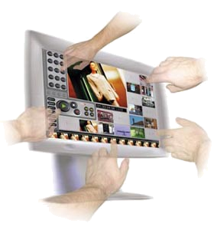



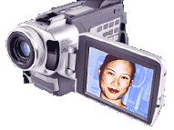
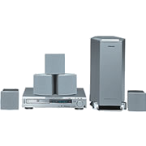
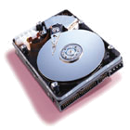

Where is DSP ?
Name one area which does not need any digital signal processing technology?
…And much more!

Slide 6
DSP in Education

Slide 7
Why We Learn DSP ?
Important processing method for broad applications
Most common working domain
A suitable career

Slide 8
What in DSP ?
Discrete time Signals & Systems
Statistical DSP
Frequency transforms
Convolution, Correlation Principles
Digital Filtering
Digital Image Processing
Advance techniques like predictive, adaptive, etc
…. and more
?
Input Signal
ADC
DAC
Output Signal
Analog to Digital Converter
Digital to Analog Converter

Slide 9
DSP Systems
Complexity v/s Sampling Rates
Sample rate
(Hz)
3G
1,000,000
Image compression
Image recognition
Encryption
Voice coding
MP3
Voice recognition
10,000
Speech synthesis
Modem
100
DSP, 70% for wireless
Gain control
1
Temperature
Low
Algorithm complexity
High

Slide 10
DSP Systems - Market
Boom 3G
+25%, 10B$?
DSP & MCU market
(Billion $)
+27%
TI
49%
8
DSP, the rising market
+20%
6
8 bit µ-controlers
Freescale
14%
4
16 bit µ-controlers
2
32 bit µ-controlers
95
97
99
01
03
05

Slide 11
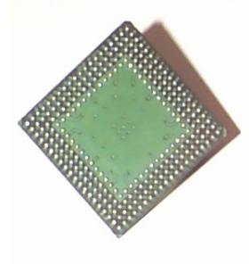
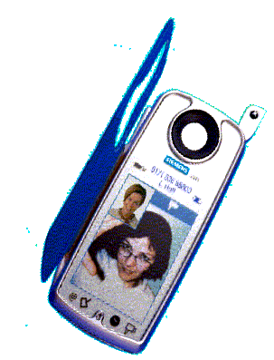
DSP Systems – Data Resolution
Fixed or float ?
DSP
Fixed-point
Floating point
16 bits
24 bits
32 bits
☺ Simple hardware
☺ low cost, low power
☹ (-1.0 +1.0) rigid structure
☹ Up to 190dB range
☹ Complex hardware
☹ High cost, high power
☺ Very flexible
☺ Up to 1500dB range

Slide 12
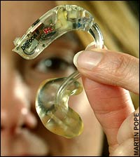
DSP Systems - Applications
Hearing Aid
Gain Processing
Digital Feedback Reduction (DFR).
Digital Noise Reduction (DNR).
Digital Speech Enhancement (DSE).
Directional Microphones and DSP
Do we need DSP here ?

Slide 13
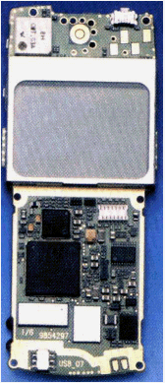
DSP Systems - Applications
Performance & Complexity
DSP in GSM
20% of code
80% of MIPS
Speech coding
Speech encryption
Modem algorithm
Echo cancellation
Midi
MP3 decoding
Image compression
Speech recognition
Speech synthesis
1G
2G
3G
Increased complexity of embedded algorithms
Needs for high performance dedicated circuits

Slide 14
Digital camera
Image processing
Compression
Audio processing
Communication module
Image editing
Rest control
DSP
LCD Control
Lens/Shutter
How much work, other than DSP ?
CCD Sensor
Power
Management
Memory

Slide 15
Education Requirement
Theory
  Continuous time, discrete time systems, sampling, fourier series representation of signals ,convolution, correlation, Z-transform , DFT, FFT, DCT, FIR & IIR Filters, Multi rate DSP, ……
Practical
  Modeling of algorithms, excitation signals, system responses, result observations, effect of various methods and parameters, applications, ….

Slide 16
Learning Cycle
Theory classes backed with assignments
Necessary to learn software programming, functions, GUI, etc
Learn
Software
Functions
Application
Understanding
Theory
Concept

Slide 17
Make it Faster
Learning specialized software can increase the learning curve
How about classes can have practicals too ?
Students having friendly software to understand DSP with ease
Theory
Concept
Application
Understanding

Slide 18
Requirements for Educating DSP
Faster learning curve
Theory with visual presentation & practice
Self learning platform
Forever understanding of DSP concepts
Realization of assignments & mini-projects

Slide 19


Slide 20
Mentor-DSP
Mentor-DSP is an easy to use, interactive software tool cum comprehensive learning resource for various signal processing techniques, DSP functions, communication methods, statistical analysis, speech synthesis, and Image processing.
It is simple, intuitive and straightforward to use, targeted to students in the field of digital signal processing.

Slide 21


Who can use Mentor-DSP
Students
Mentor-DSP will make learning DSP more interactive
Helps in understanding the complex DSP techniques
Helps in visualization of theory classes in an illustrative manner
Explains from basic to advanced concepts in DSP

Slide 22

Who can use Mentor-DSP
Teachers
Generally students do not enjoy complex mathematical DSP algorithms in theory classroom?
There is so much to teach in DSP and so small the time you get to cover the subject, isn’t it?
How much time is spent to draw & illustrate resulting waveforms on drawing boards? and yet they are not alive.
Mentor-DSP will make your classroom & labs alive when you teach the complex DSP techniques

Slide 23
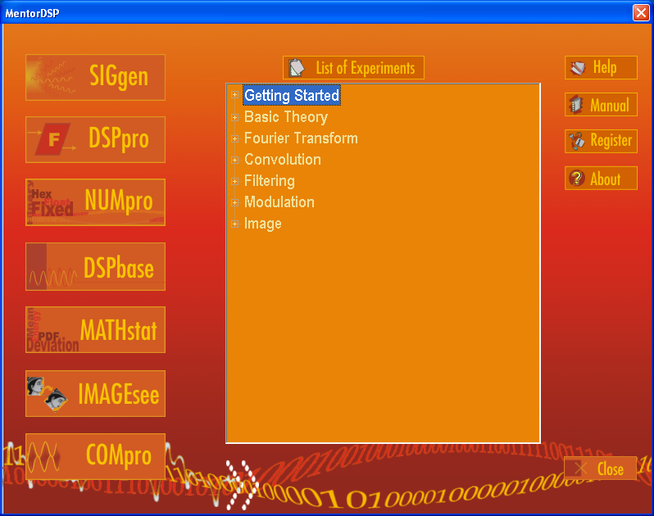
Welcome Screen

Slide 24
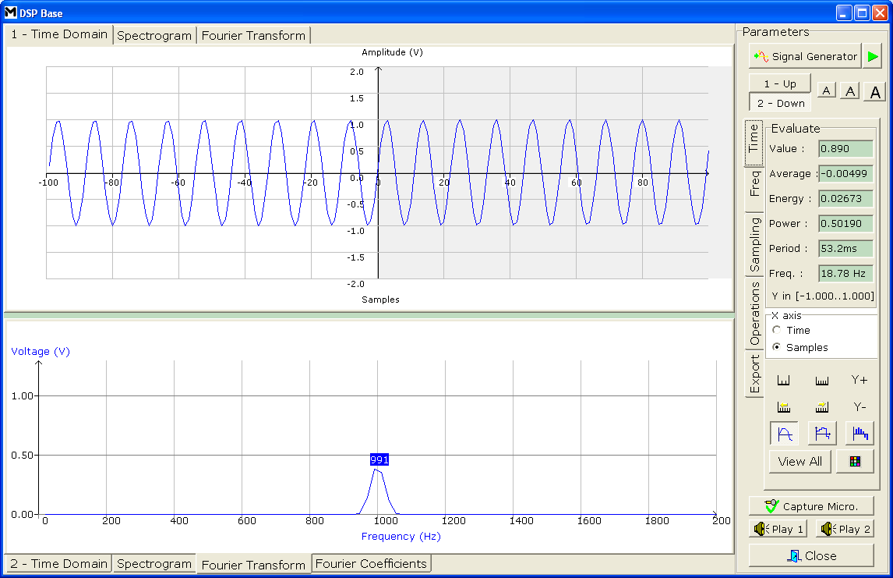
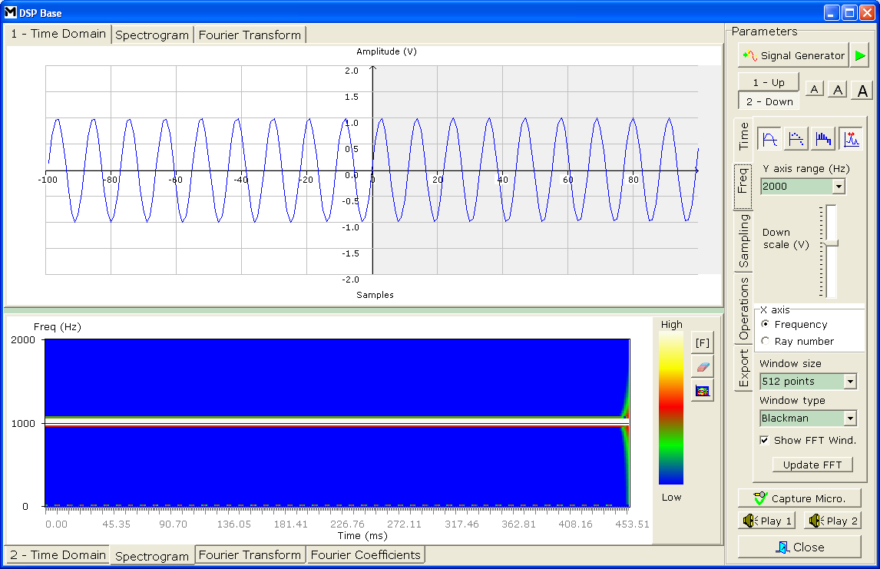
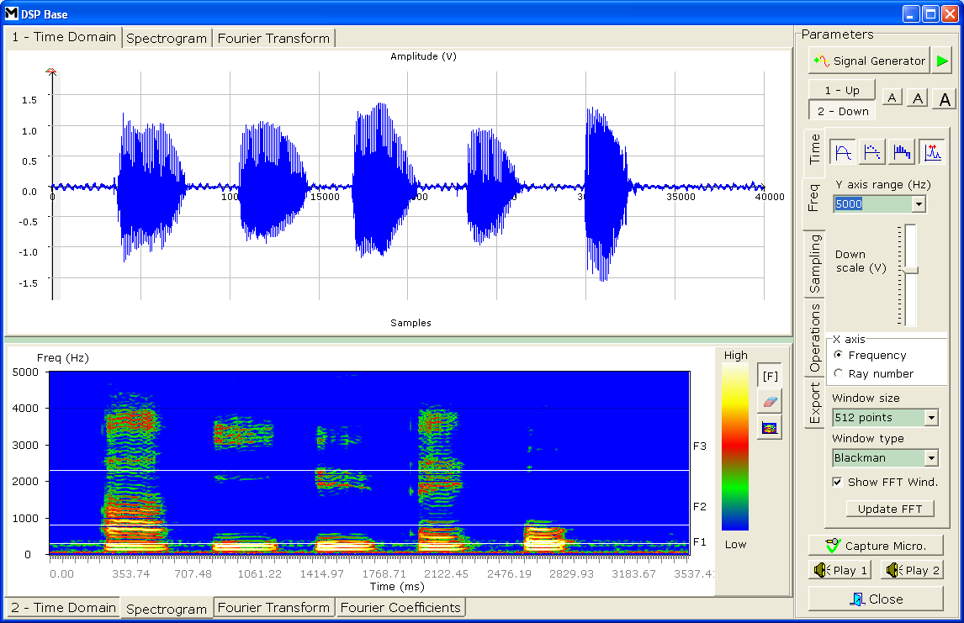
User Friendly GUI
Easy Access
menus
Two screens
simultaneously
Multiple Results

Slide 25
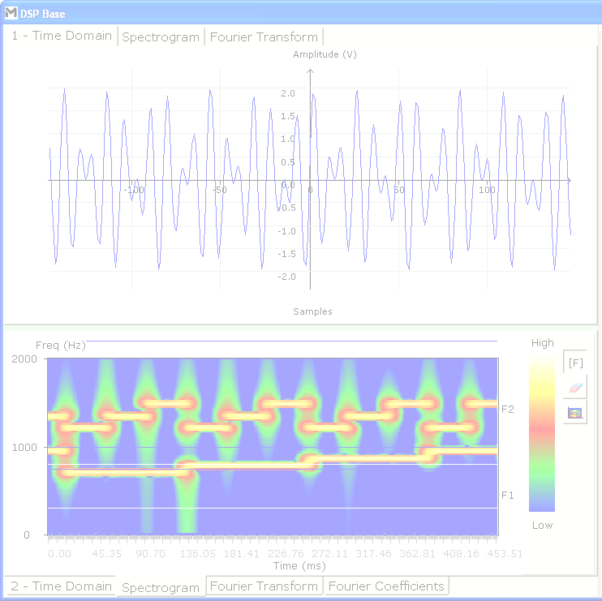
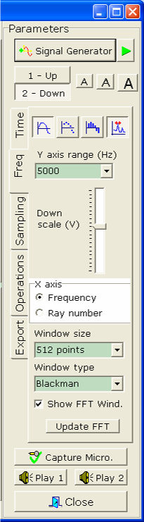
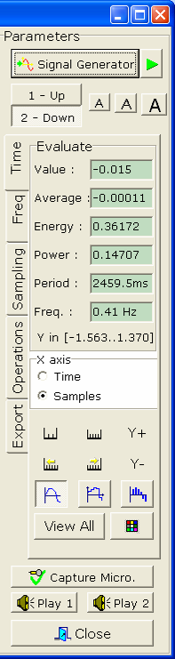
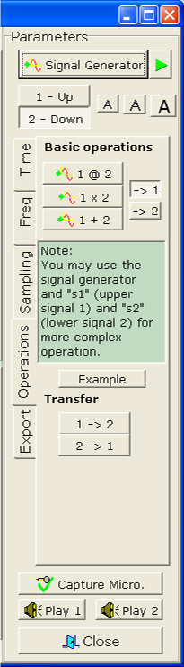
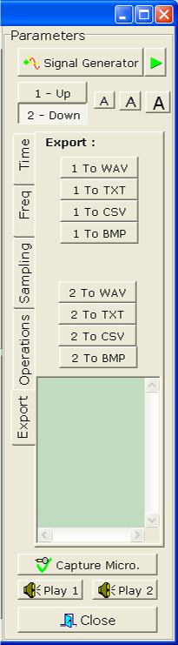
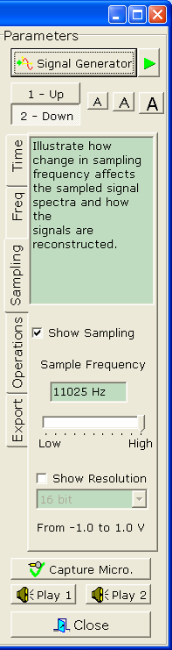
User Friendly GUI
Easy Access
menus
Time
Frequency
Sampling
Operations
Export

Slide 26
Mentor-DSP Modules
Mentor-DSP is divided into various modules which cover various DSP aspects. These modules are not only user friendly in navigation but also easy to use.
DSPbase Basic DSP
NumPro Data Formats
SigGen Signal Generator
DSPro DSP Functions
MathSTAT Statistical DSP
ImageSEE Image Processing
ComPro DSP for Communication

Slide 27
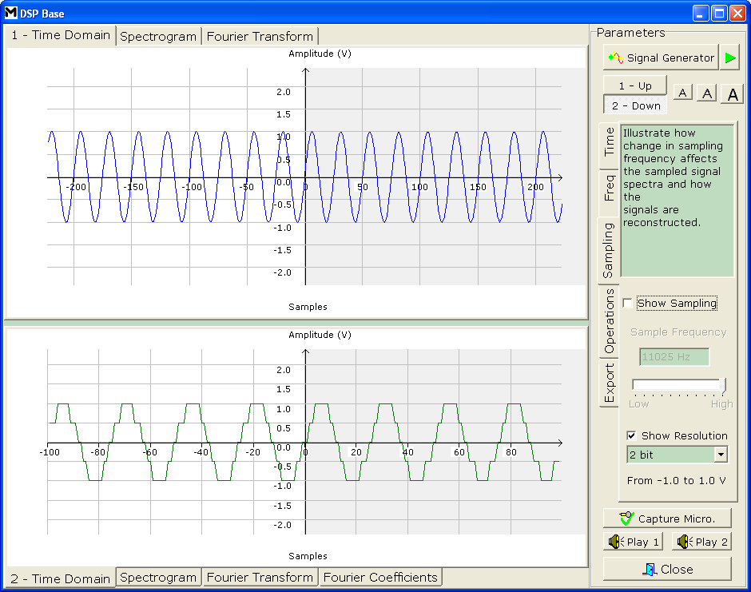
DSPbase
To start DSP with basics; sampling of analog signals, quantization, calculating energy and power in signals; this section helps engineer to learn basics with ease.
Highlights:
Sampling theorem
ADC resolution (up to 32-bits)
Energy, Power, Average, Period and Frequency of required signals
Probability density function

Slide 28
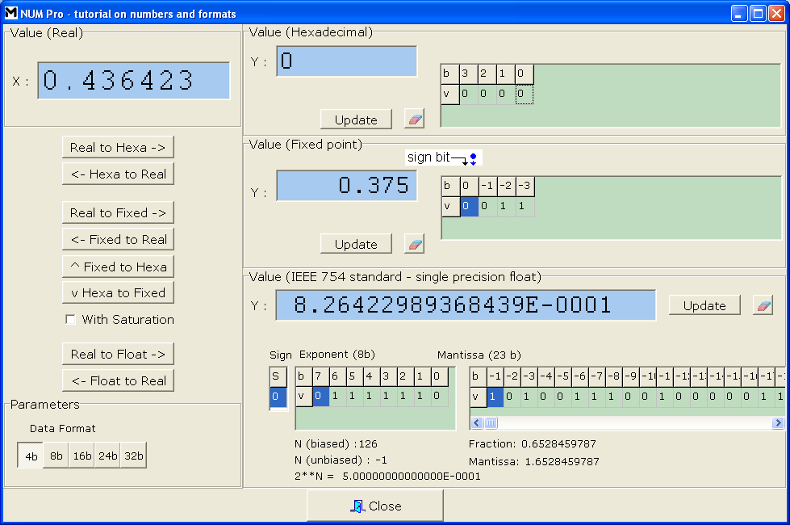
NUMpro
This section helps engineers to understand the various data formats used for signal processing. Engineers can understand the concept of coding schemes and their requirements in various applications.
Highlights:
Various coding schemes (Real, Hexadecimal, Fixed point, Floating point and conversion among these).
4 to 32-bits precision
Range from -1.0 to +1.0

Slide 29
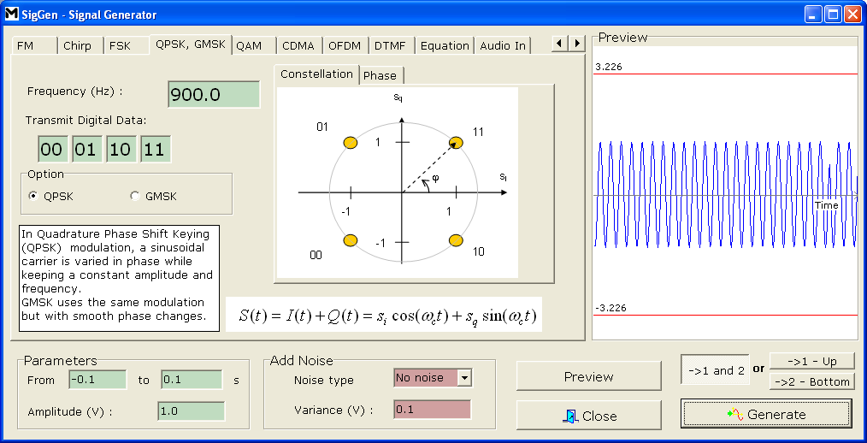
SIGgen
Categorized for different domains of DSP like audio, communication, analysis, etc.
Learn signals types and their properties.
More than that signal generator helps engineers to understand which kind of signals to be used for various DSP applications.
Highlights:
Covers all basic signals
AM, FM, FSK, QPSK, GMSK, OFDM, DTMF etc.
Noise, with specified distributions (white, Gaussian) can be added to signals.
Generate signals using equations
Audio signal input using wave files

Slide 30
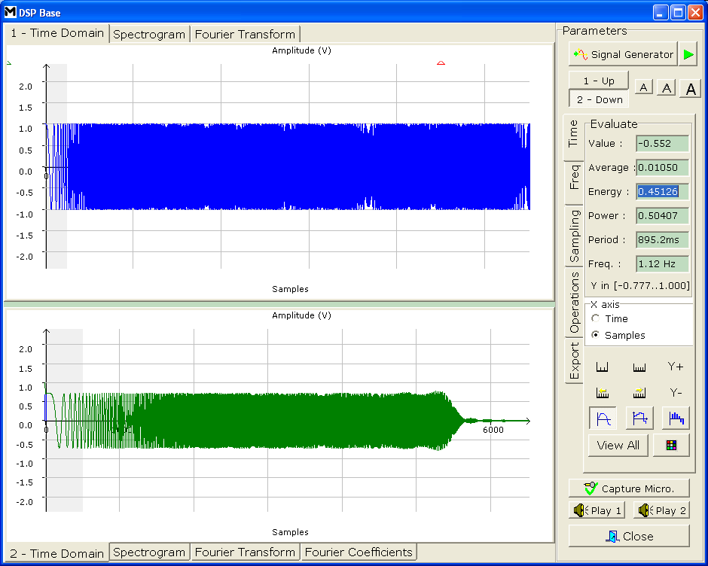
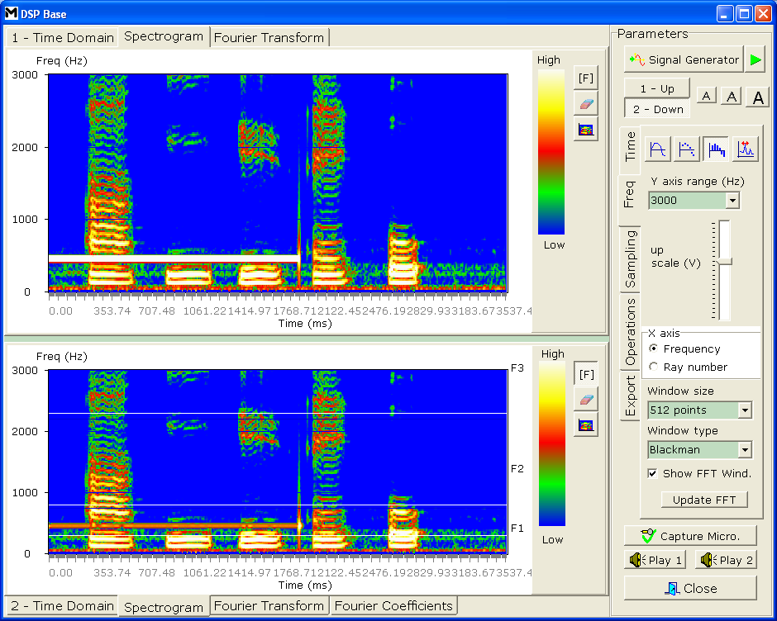
DSPpro
DSPpro has a wide range of DSP and arithmetic functions which can be applied to, or between, signals.
Standard DSP functions include FFT analysis, convolution, correlation and filtering.
Highlights:
FFT, IFFT calculation
Real time FFT for Microphone audio input
Real time 2-D Spectrogram with Microphone input
Filter design support
Import/Export of coefficient for filters
Convolution and Correlation operations

Slide 31
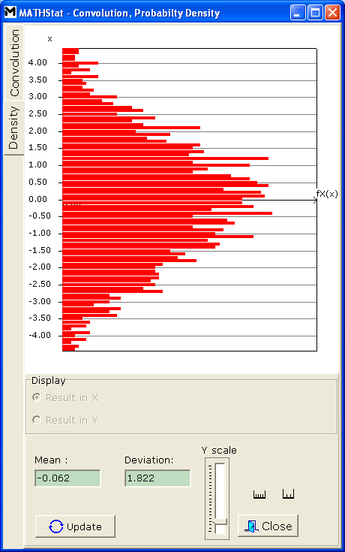
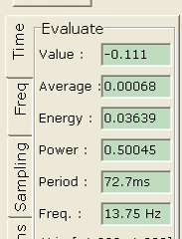
MATHstat
Most of DSP applications are concerned with statistics of signals
With this engineers can easily learn and practice the mathematics involved behind statistical calculations of signal.
Highlights:
Mean and Standard deviations
Probability Density Function (PDF)
Probability Distribution, Density Function, Period, Frequency, value, Average, Standard Deviation of signals

Slide 32
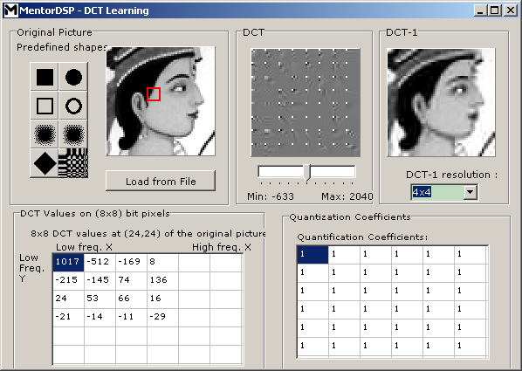
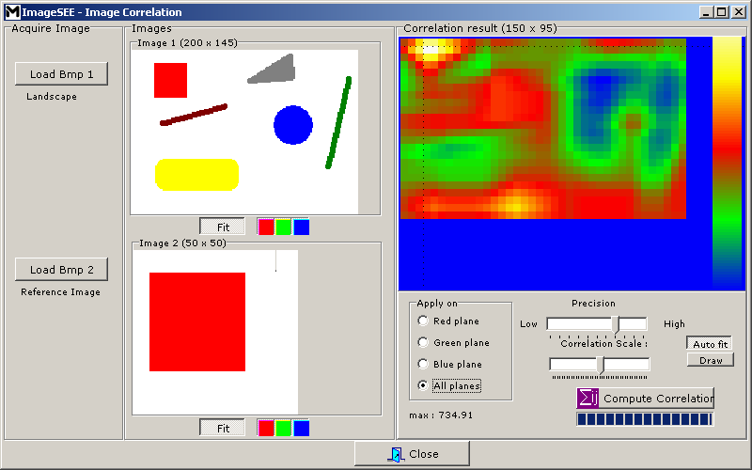
IMAGEsee
Mentor-DSP has exhaustive list of image processing learning resources.
This section will give engineers an interactive platform to learn image processing.
Highlights:
Image properties & statistics
Perform binary and arithmetic operations
Discrete Cosine Transform (DCT)
Image transformation
Image correlation
Facility to noise to image
Filtering for images

Slide 33
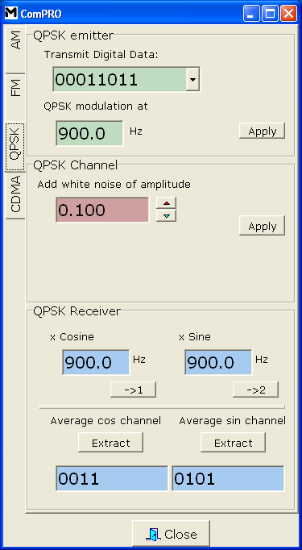
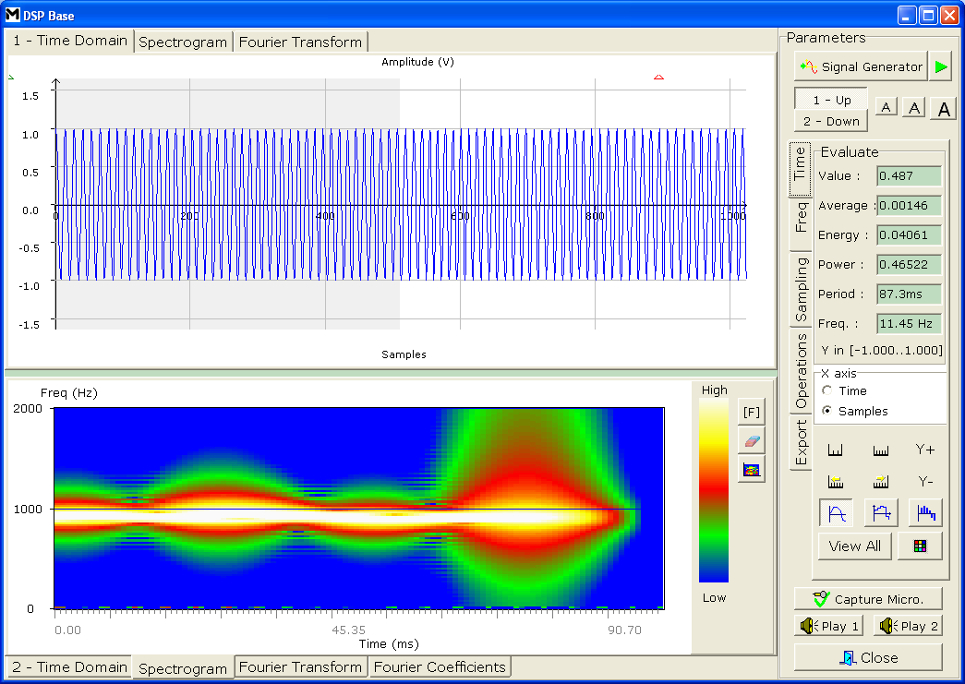
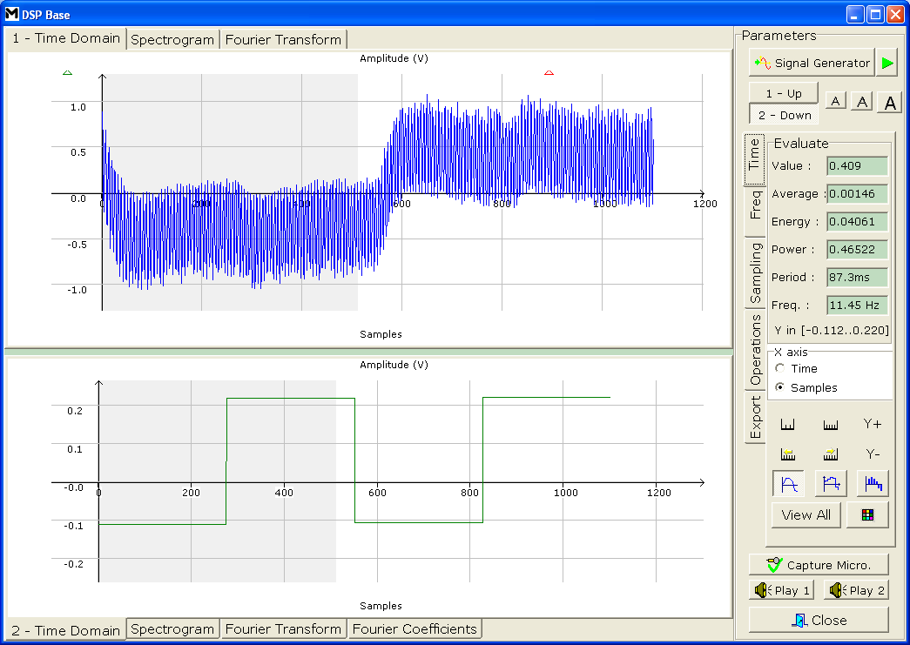
COMpro
Mentor-DSP can illustrate various modulation techniques available for communication. It can perform modulation on signals giving access to the key parameters such as the modulation amplitude and signal frequencies, etc
Highlights:
Amplitude Modulation (AM)
Frequency Modulation (FM)
Quadrature Phase Shift Keying (QPSK)
Gaussian Modulated Shift Keying (GMSK)
Code Division Multiple Access (CDMA) Modulation
Orthogonal Frequency Division Multiplexing (OFDM)

Slide 34
Demonstrations
Show demonstration here for
  Sampling Theorem, Nyquist criteria
  Show in real time the effect of Fourier Transform
  How to generate pure sine wave
  Make the link between time (period becomes shorter) and freq (spot become higher)
  Make a Dirac pulse (shock, FFT)
  What produces a white noise
  White noise, show how “random” it is
  Image Processing

Slide 35
Conclusion
Mentor-DSP is an easy to use, interactive software tool cum comprehensive learning resource for various signal processing techniques.
A true Mentor for Digital Signal Processing

